Slide 1
Unsupervised Learning

Slide 2
Unsupervised Learning
Unlabeled data
Most data in the world is unlabeled, so there’s a lot of potential to apply unsupervised learning

Slide 3
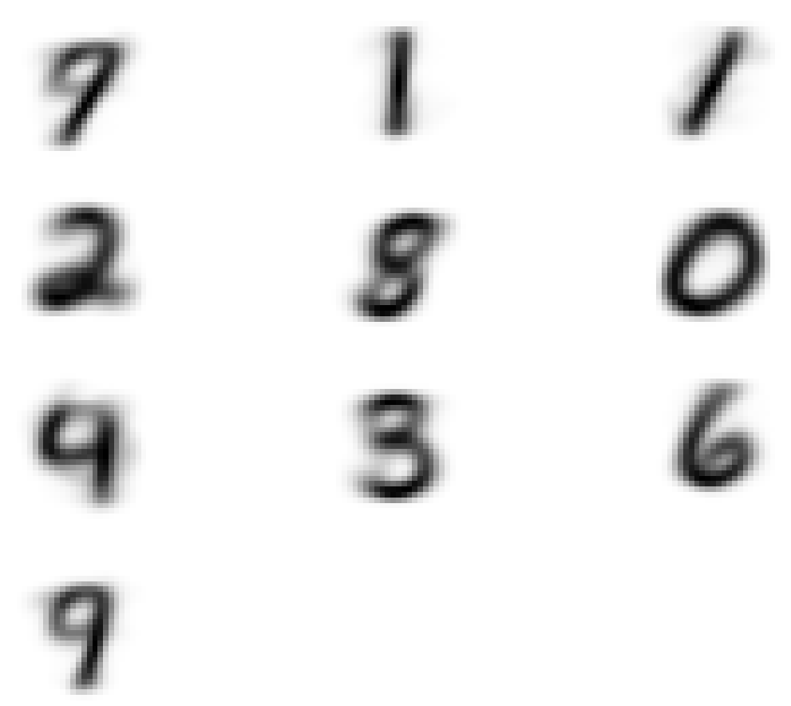
Clustering
Unlabeled data
Data has relations to each other and can be separated into categories

Slide 4
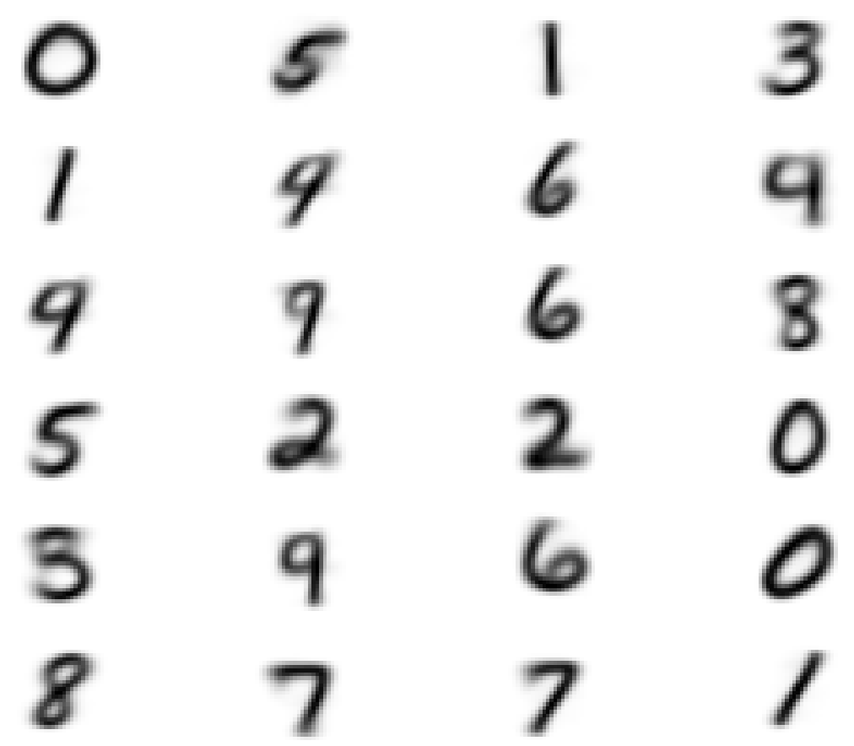
Clustering
Unlabeled data
Data has relations to each other and can be separated into categories

Slide 5

Anomaly Detection
Outliers from clusters

Slide 6
Semi-Supervised
Partially labeled datasets
Manually labeled
Automatically received labels
0
5
1
3
1
4
6
4
4
9
6
8
5
2
2
0
3
9
6
0
8
7
7
1

